Slide 1

Visión por Computador
Domingo Mery
Departamento de Ciencia de la Computación
Escuela de Ingeniería
Universidad Católica de Chile
GAN

Slide 2
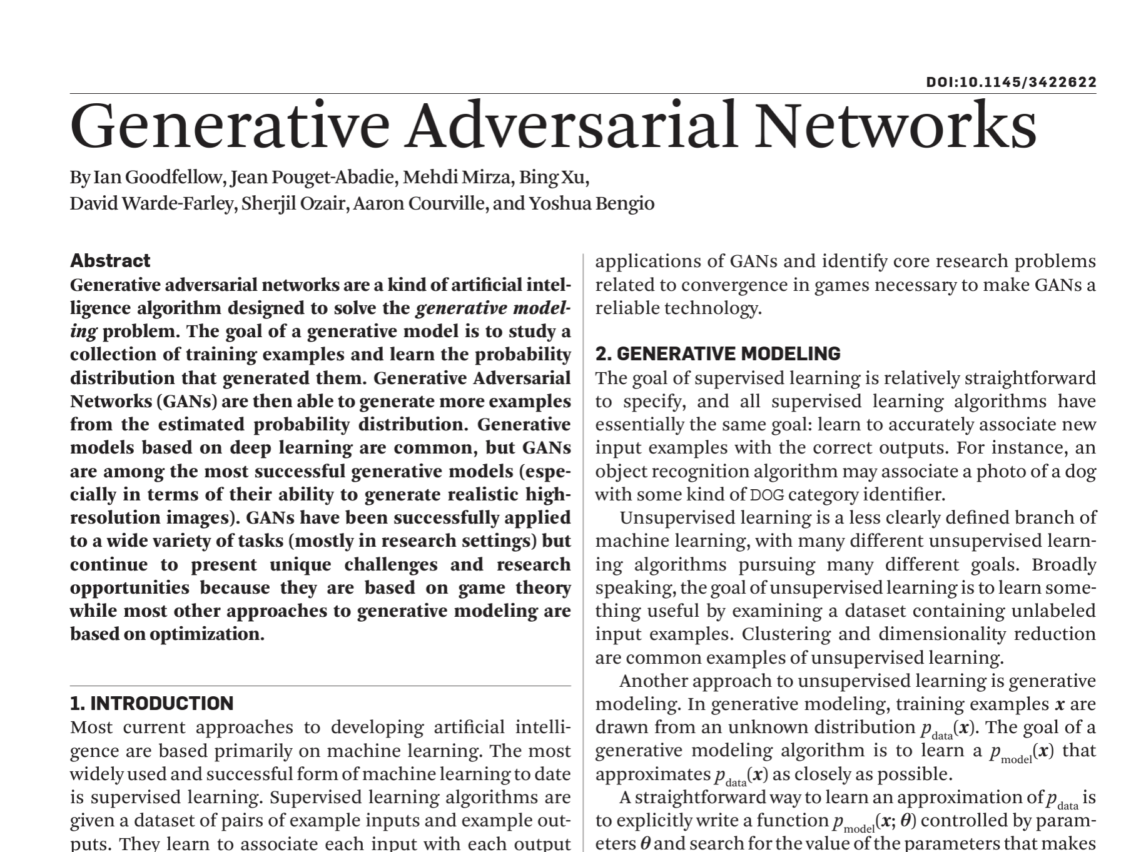

Slide 3
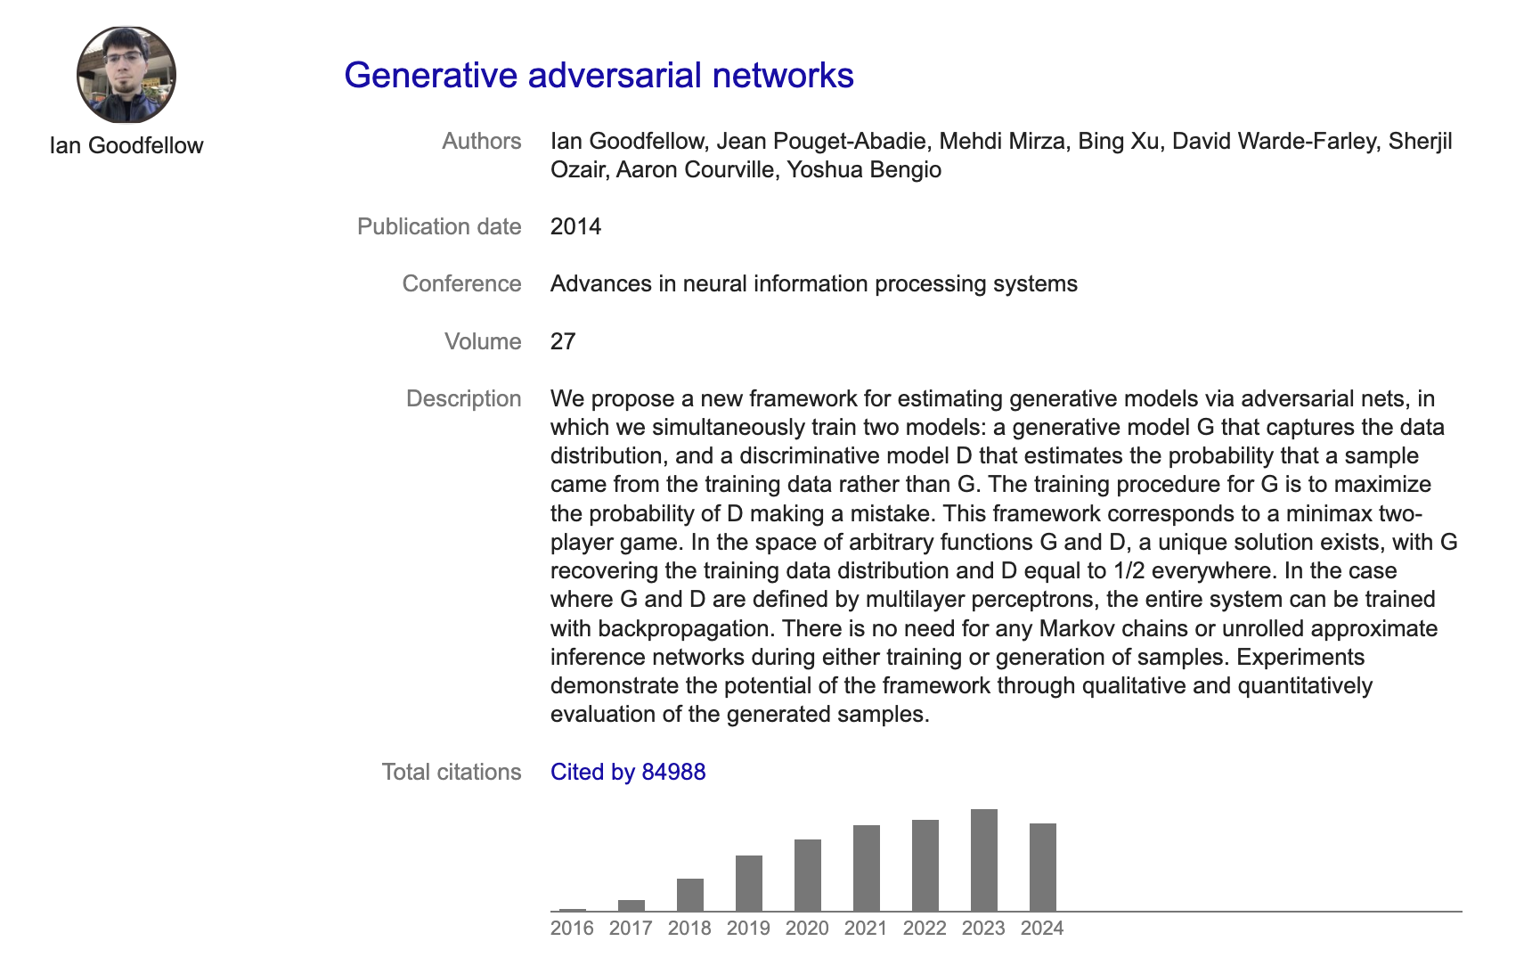

Slide 4

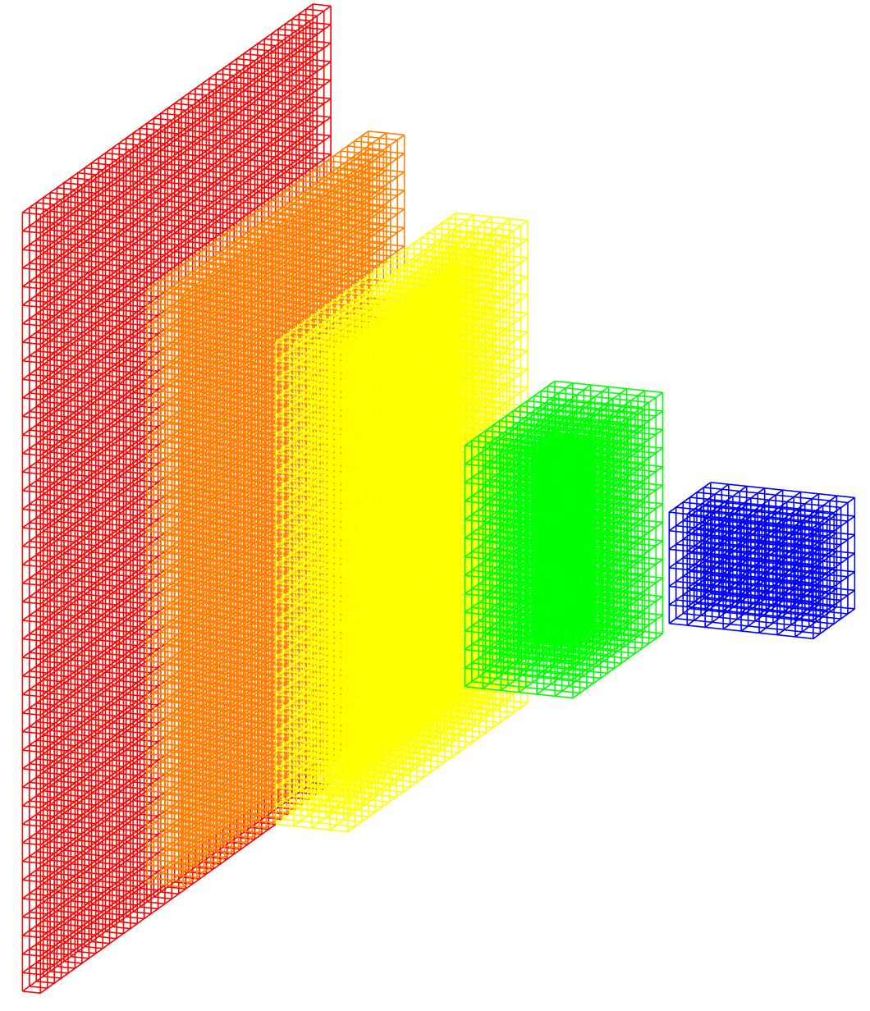
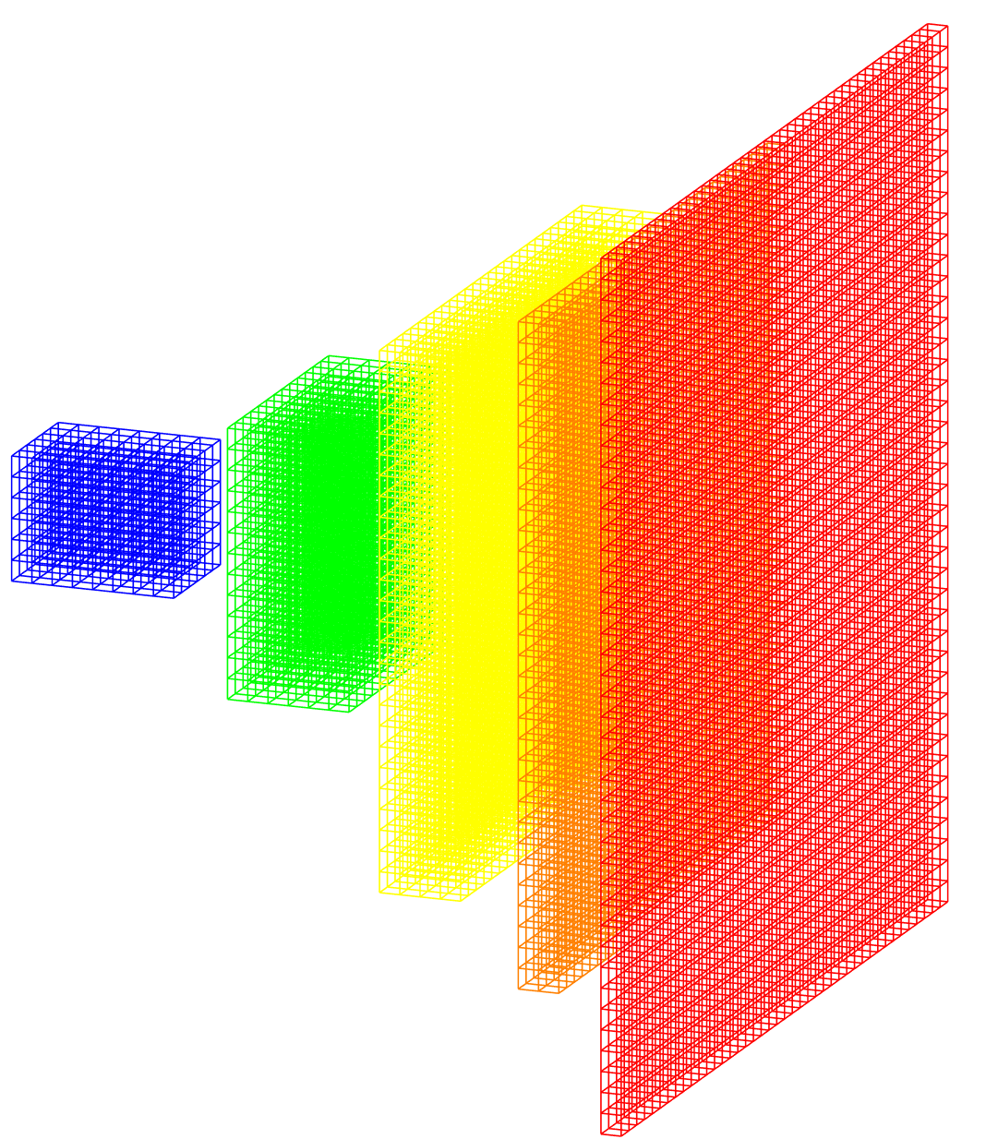
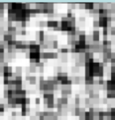
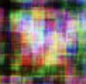
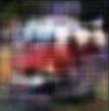
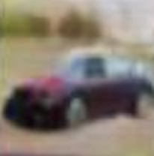
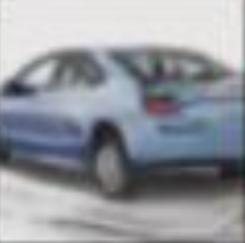
GAN: Generative Adversarial Network
Ground truth: real/fake
Real image
Discriminator
real/fake
Generator
error
Noise
Fake image
Iter = 1 500 10,000 50,000
error
Notes:
Zero-sum game theory

Slide 5
GAN: Generative Adversarial Network
Ground truth: real/fake
Real image
Discriminator
real/fake
Generator
error
Noise
Fake image
Iter = 1 500 10,000 50,000
error
Notes:
Zero-sum game theory

Slide 6
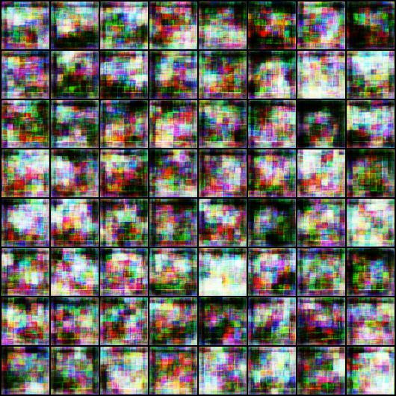
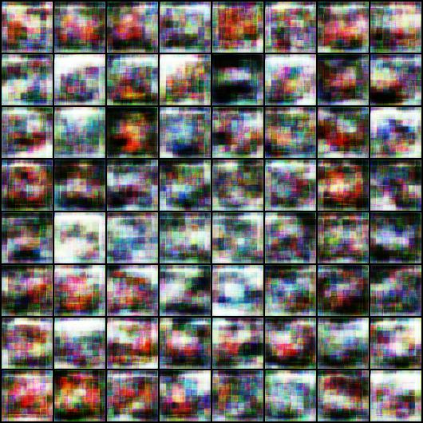
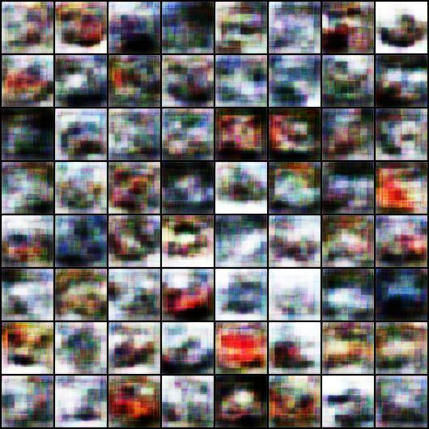
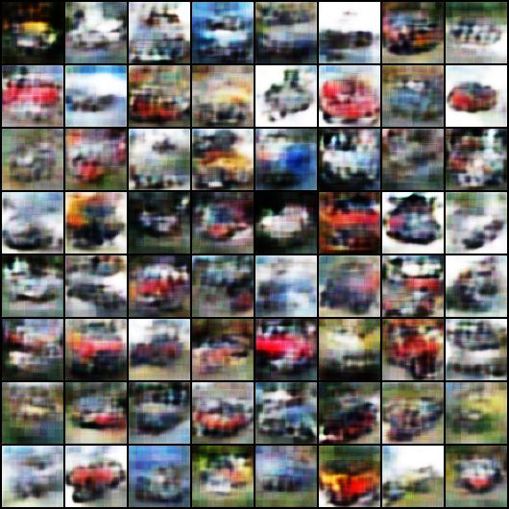
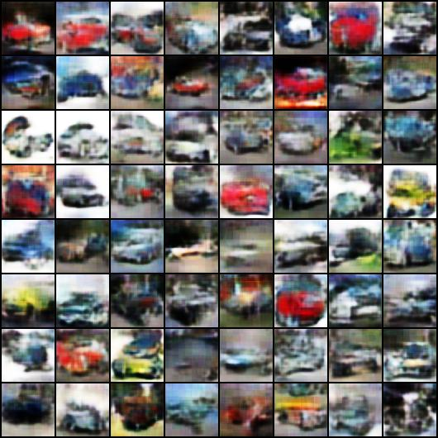
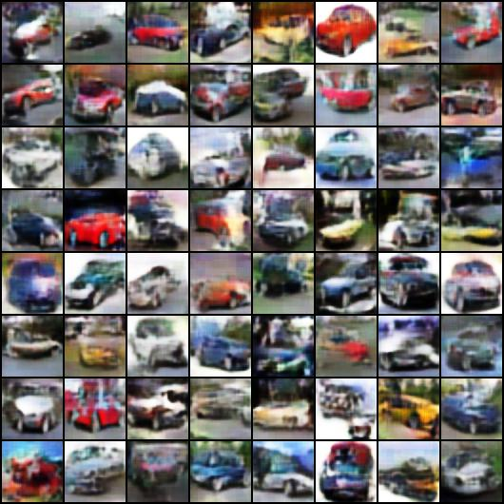
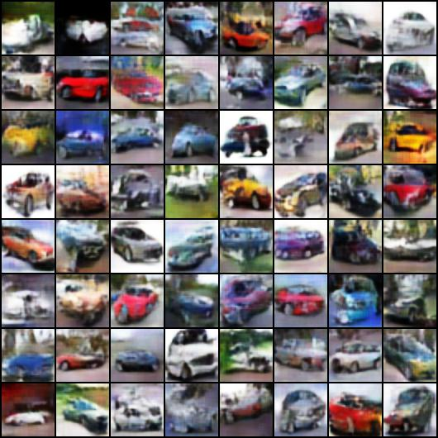
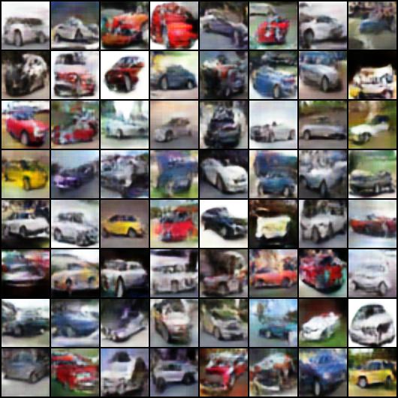
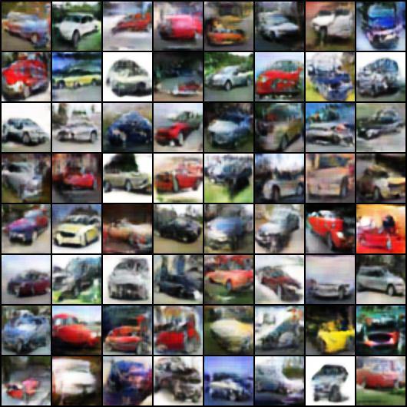
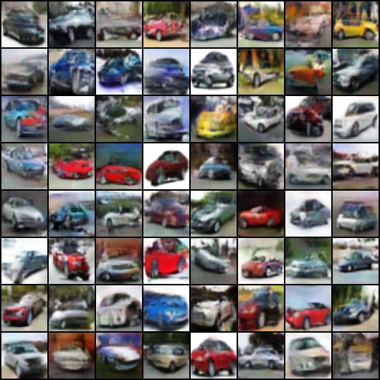
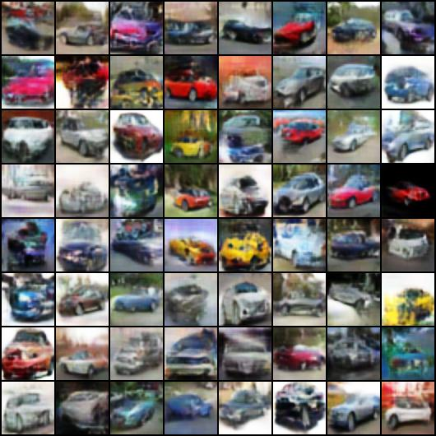
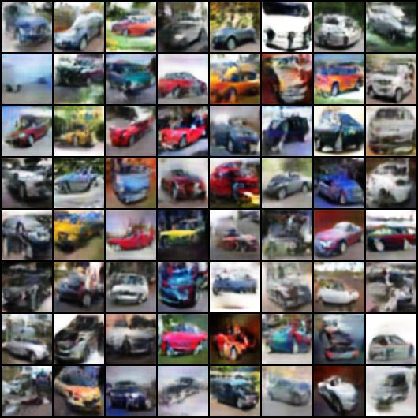
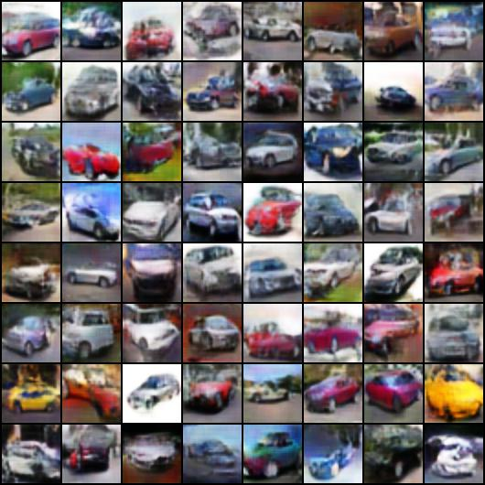
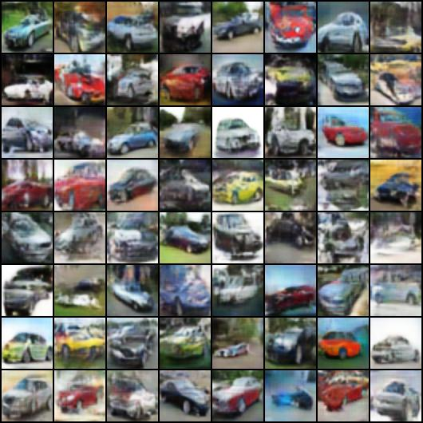
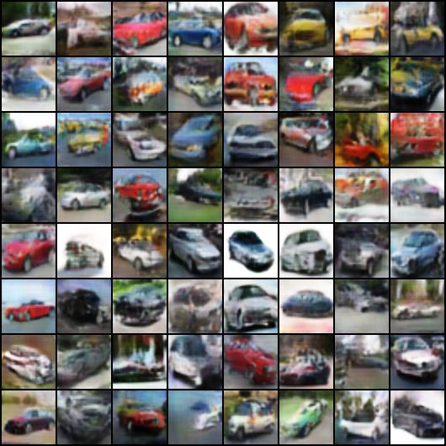
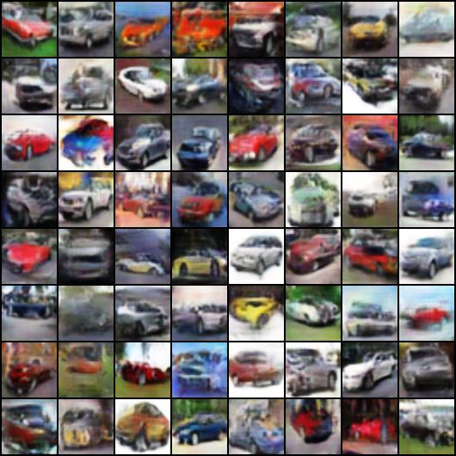
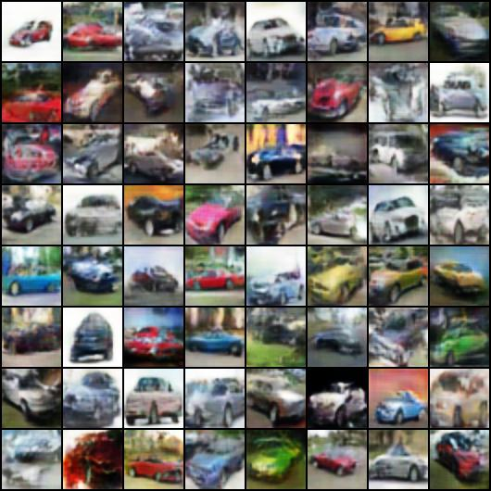
20
100
5000
iterations
13000
Notes:
-rw-r--r--@ 1 domingomery staff 94169 15 Jul 22:43 00020.jpg
-rw-r--r--@ 1 domingomery staff 80863 15 Jul 22:42 00040.jpg
-rw-r--r--@ 1 domingomery staff 67402 15 Jul 22:42 00100.jpg
-rw-r--r--@ 1 domingomery staff 62770 15 Jul 22:42 00500.jpg
-rw-r--r--@ 1 domingomery staff 59893 15 Jul 22:42 01000.jpg
-rw-r--r--@ 1 domingomery staff 61521 15 Jul 22:41 02000.jpg
-rw-r--r--@ 1 domingomery staff 60250 15 Jul 22:41 03000.jpg
-rw-r--r--@ 1 domingomery staff 59664 15 Jul 22:41 04000.jpg
-rw-r--r--@ 1 domingomery staff 59934 15 Jul 22:40 05000.jpg
-rw-r--r--@ 1 domingomery staff 58940 15 Jul 22:40 06000.jpg
-rw-r--r--@ 1 domingomery staff 58243 15 Jul 22:40 07000.jpg
-rw-r--r--@ 1 domingomery staff 59878 15 Jul 22:40 08000.jpg
-rw-r--r--@ 1 domingomery staff 58025 15 Jul 22:40 09000.jpg
-rw-r--r--@ 1 domingomery staff 57869 15 Jul 22:42 10000.jpg
-rw-r--r--@ 1 domingomery staff 57937 15 Jul 22:42 11000.jpg
-rw-r--r--@ 1 domingomery staff 58064 15 Jul 22:41 12000.jpg
-rw-r--r--@ 1 domingomery staff 58081 15 Jul 22:41 13000.jpg

Slide 7
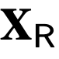
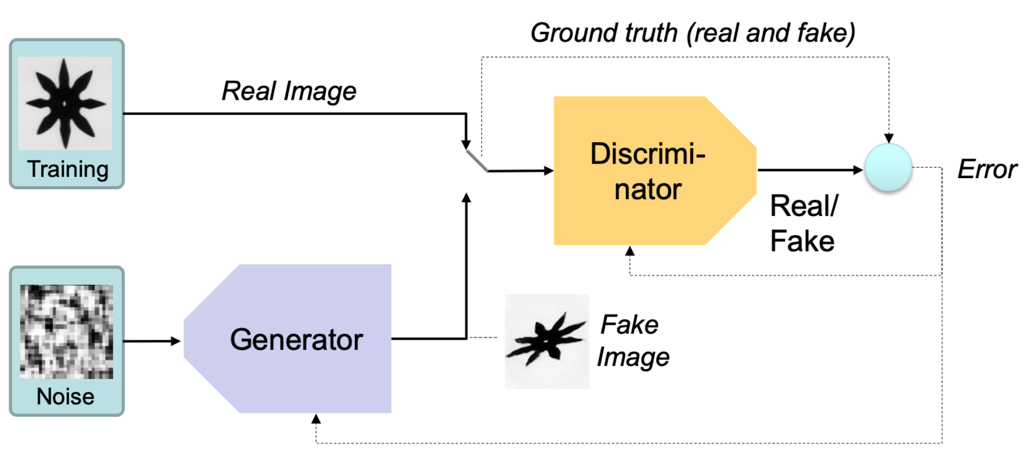
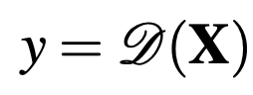
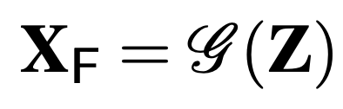
y
Z

Slide 8
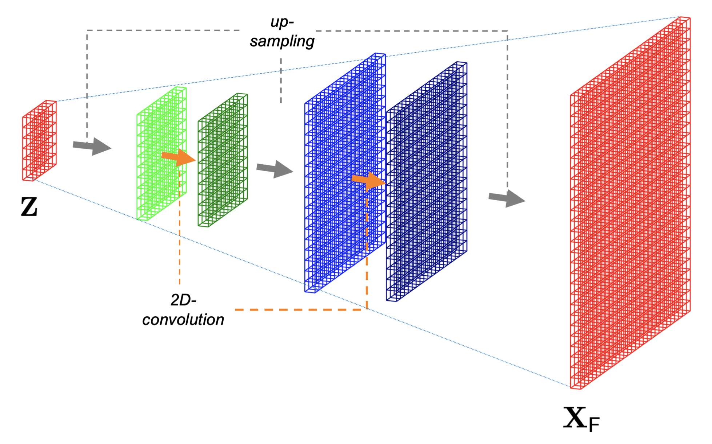

Slide 9
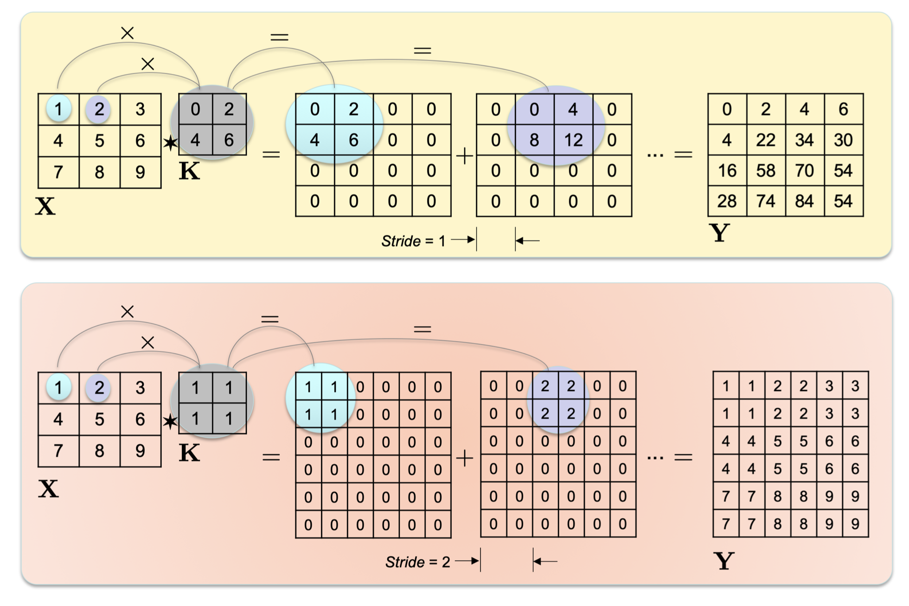

Slide 10
1: real
0: fake
y
Z

Slide 11
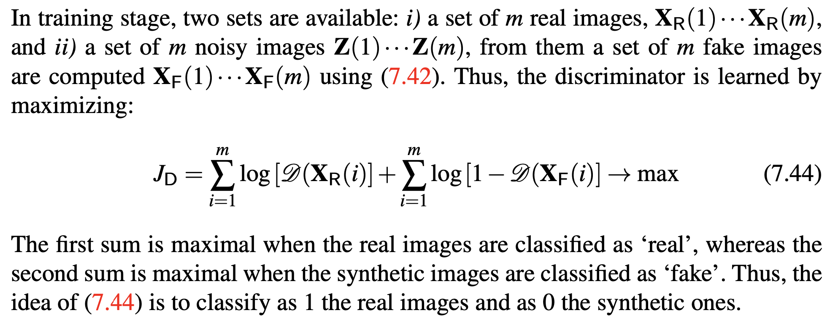

Slide 12
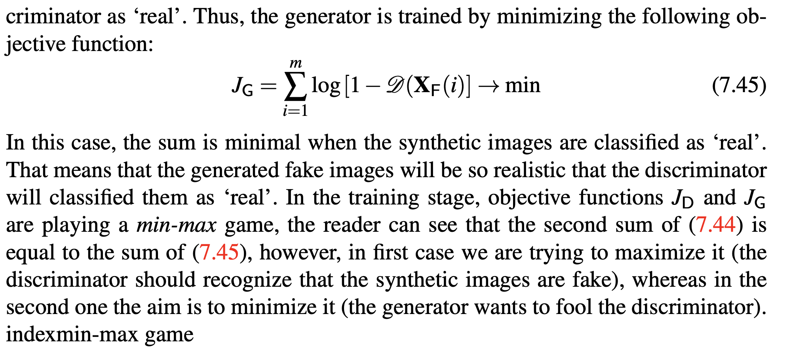

Slide 13
1: real
0: fake
y
Z

Slide 14
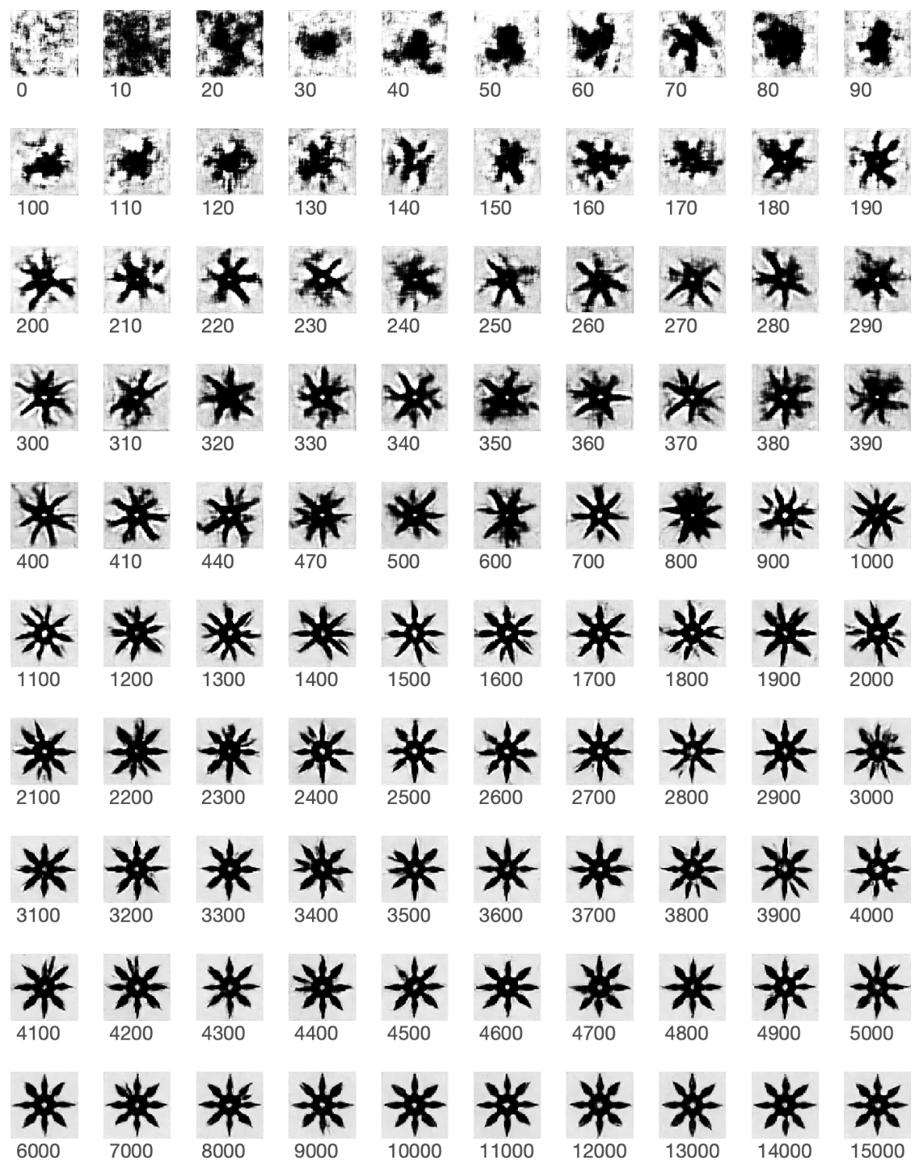
GAN: Shuriken

Slide 15
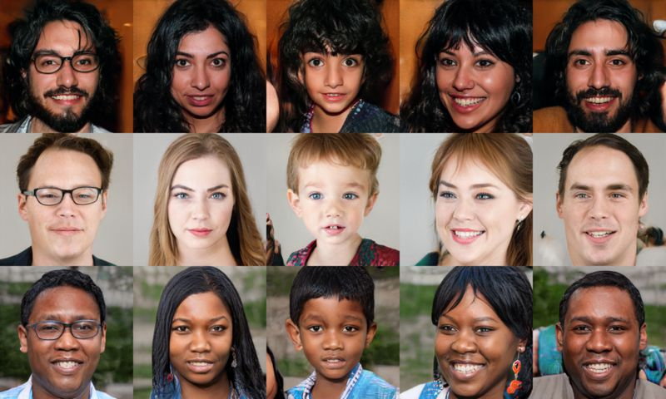
www.ThisPearsonDoesNotExist.com

Slide 16
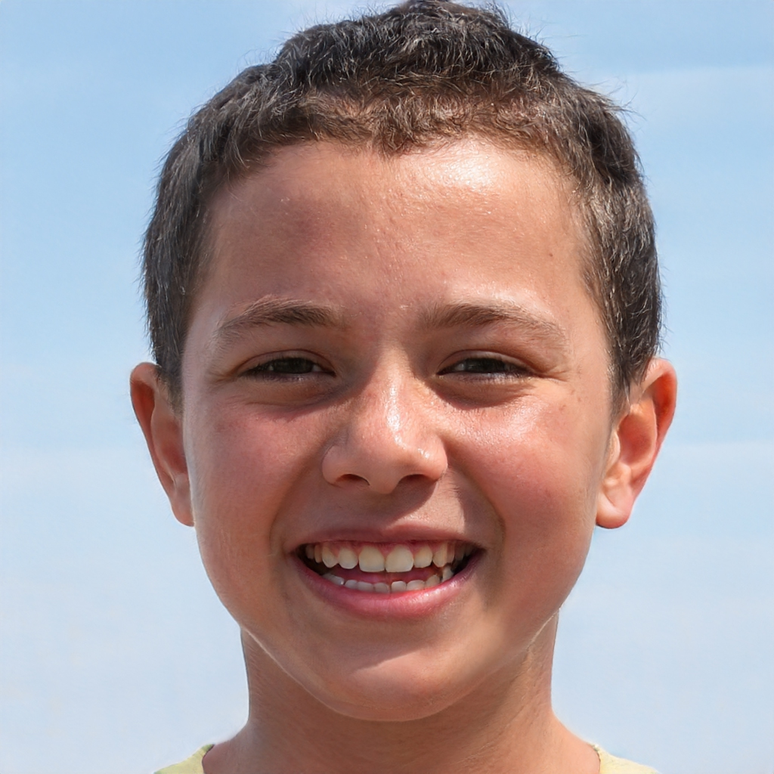

Slide 17
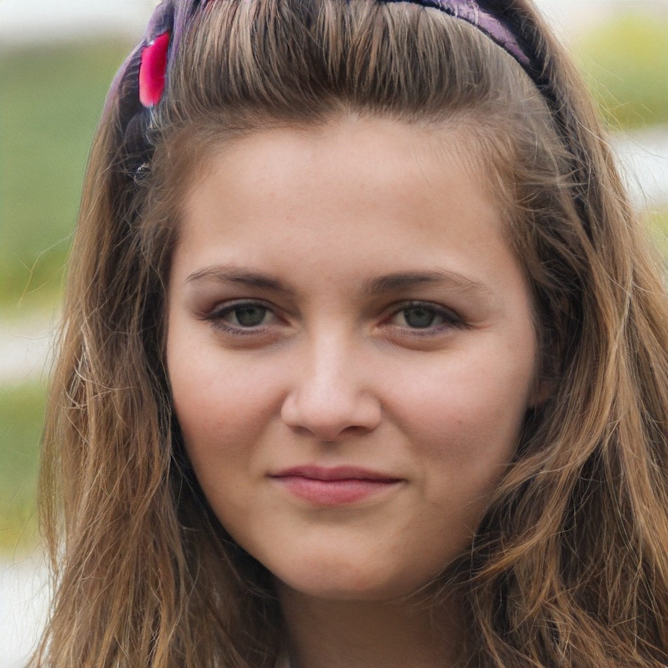

Slide 18
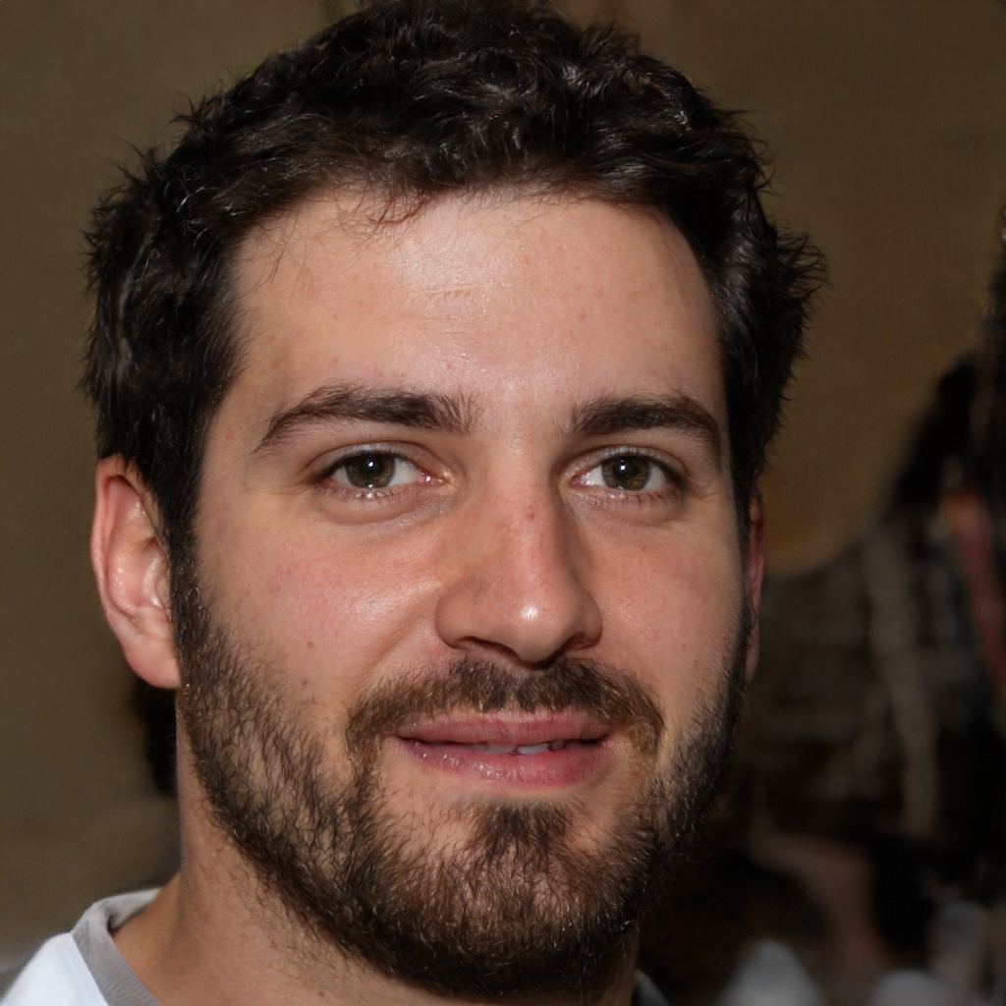

Slide 19
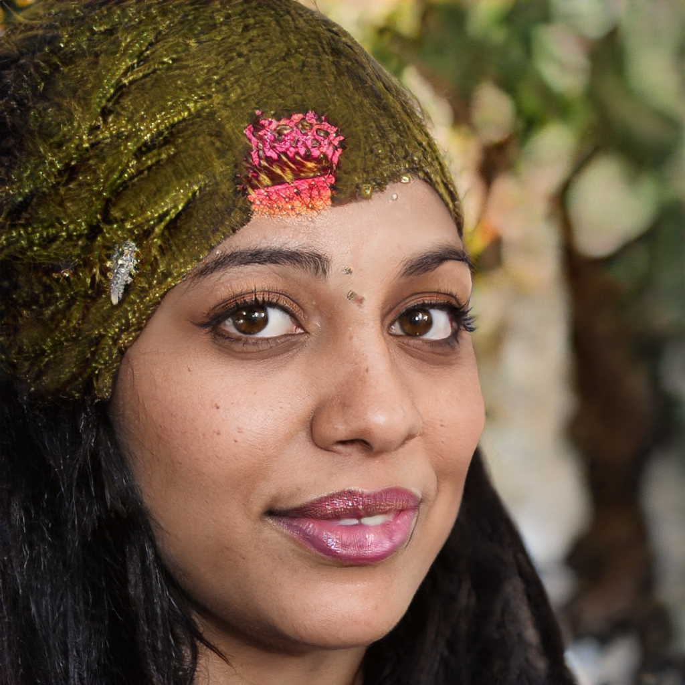

Slide 20
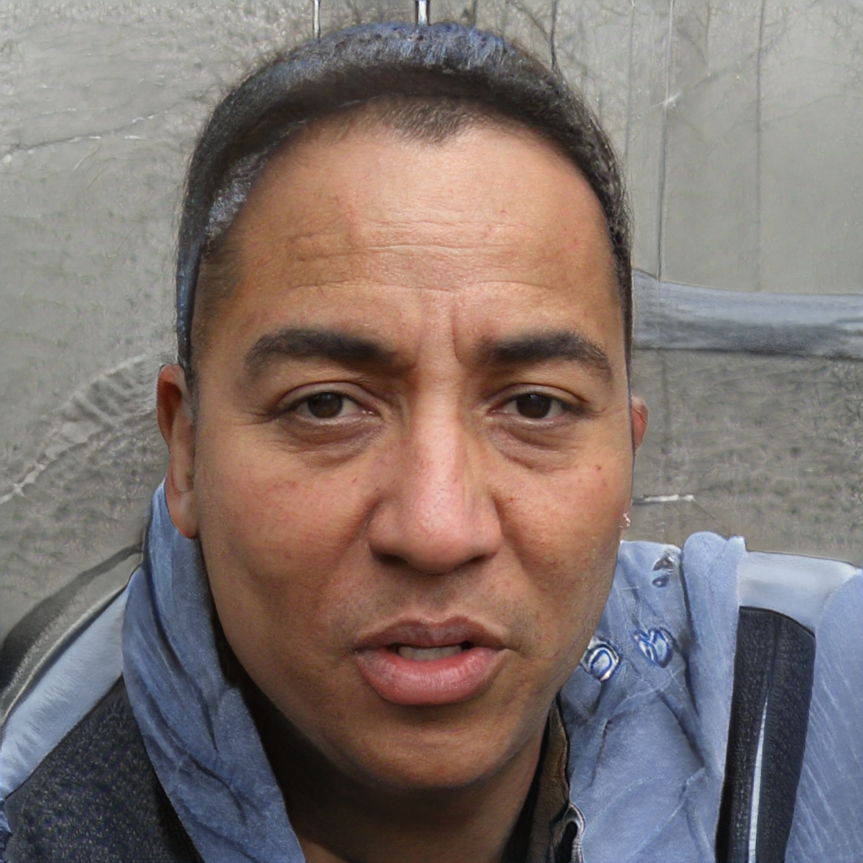

Slide 21
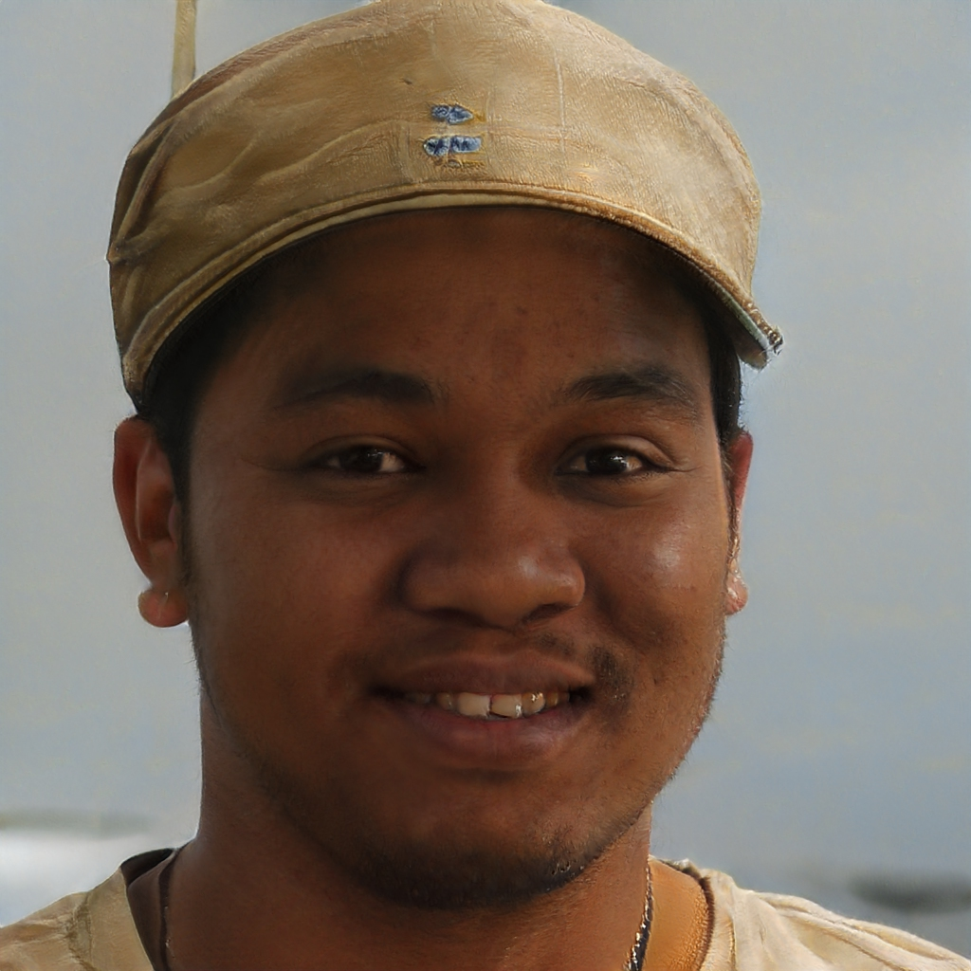

Slide 22
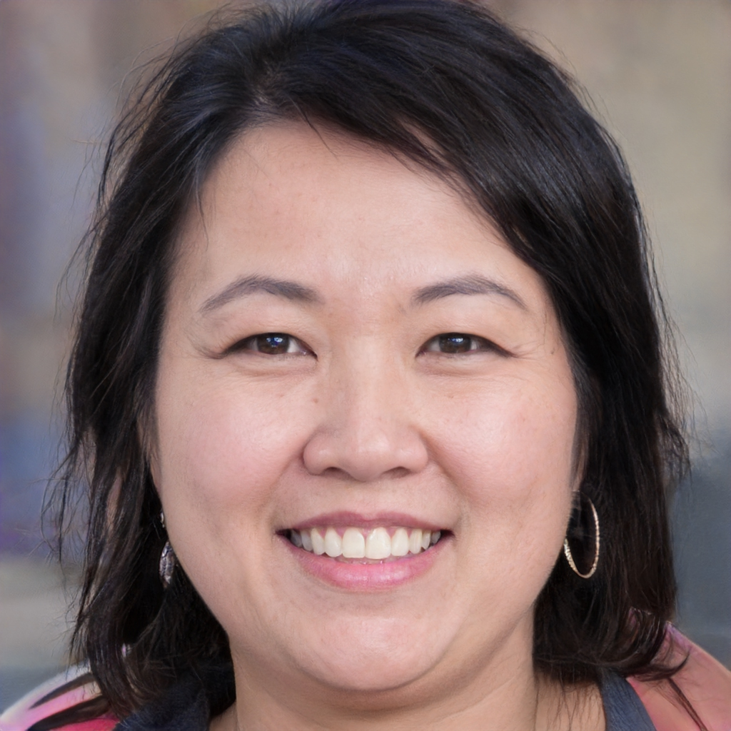

Slide 23
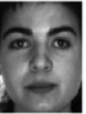
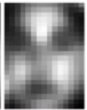
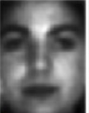
GAN para Super-Resolution
1: real
0: fake
y
Hi-Resolution
Low-Resolution
Z

Slide 24
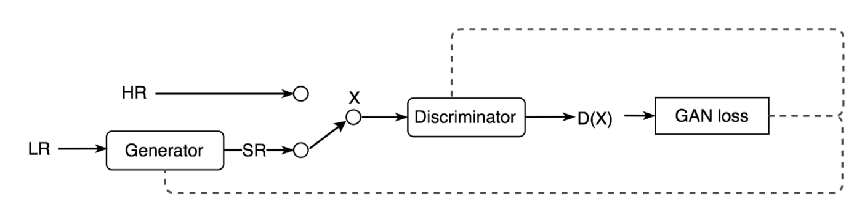
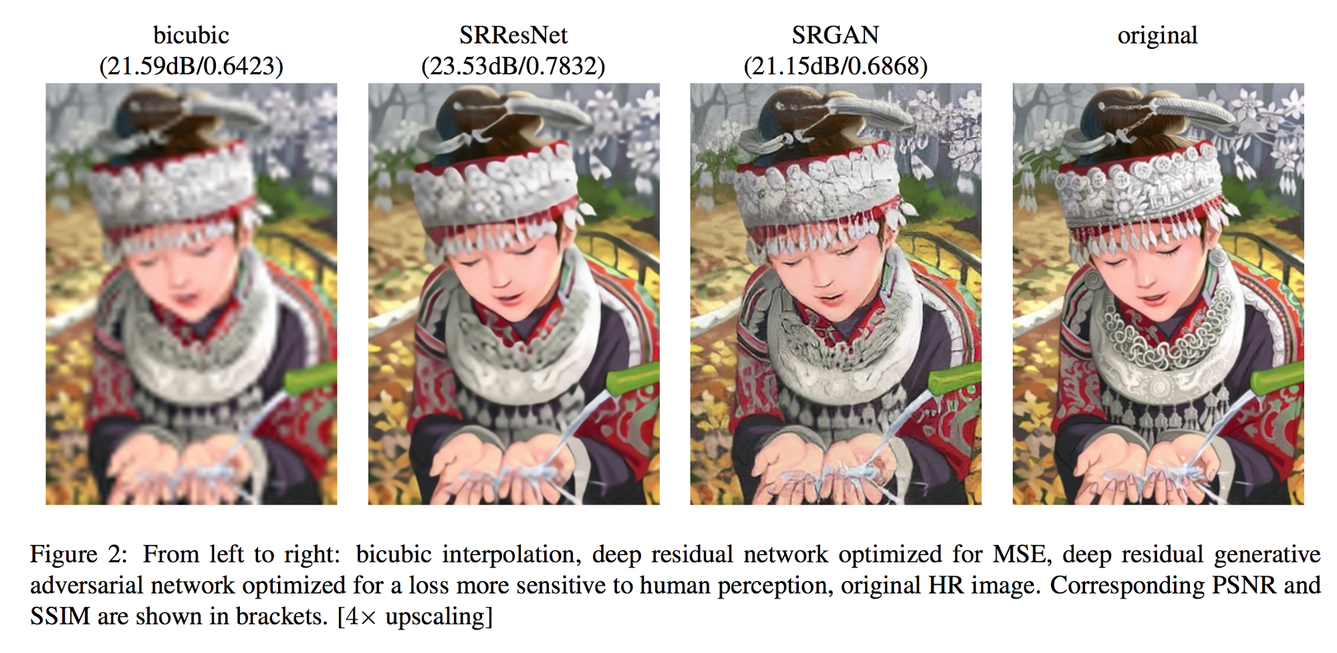

Slide 25
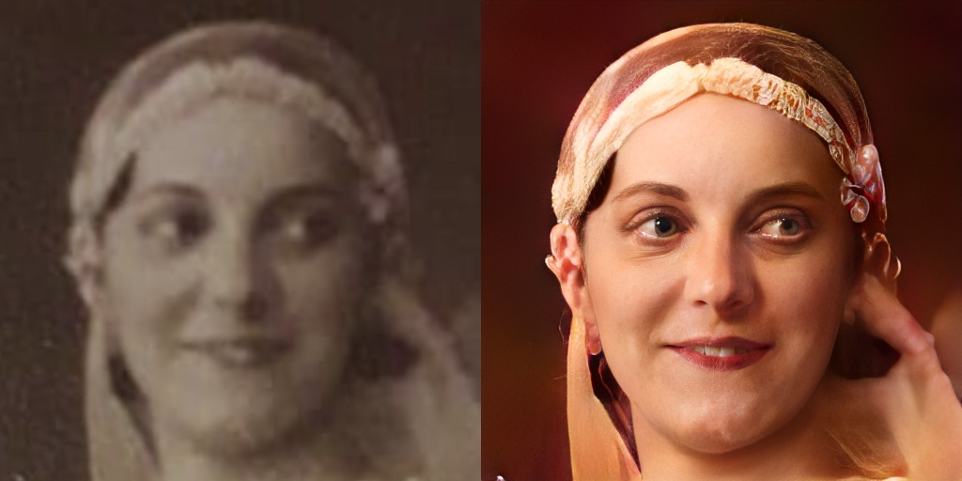

Slide 26
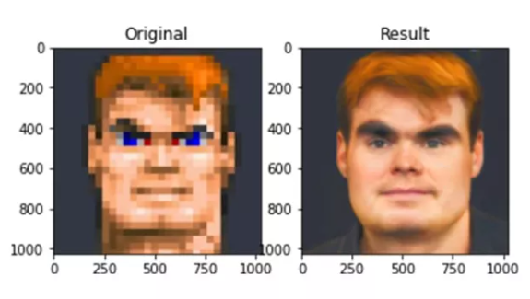

Slide 27
Algunos problemitas...

Slide 28


Slide 29



Slide 30



GAN for Super-Resolution
ORIGINAL
448x448
INPUT
56x56
OUTPUT
448x448

Slide 31




GAN for Super-Resolution
ORIGINAL
448x448
INPUT
56x56
OUTPUT
448x448

Slide 32




Problems with GANs for Super-Resolution
LR
56x56
LR
28x28
LR
14x14
ORIGINAL
112x112
HR
112x112
HR
112x112
HR
112x112

Slide 33

Example of face images with different sizes

Slide 34
Standard face verification approach
sc

Slide 35
Low-resolution face verification approach
HR:
112 x 112
LR:
a) 14x14,
b) 28x28,
c) 56x56
sc
SR:
112 x 112
UPSCALE
Prieto, L., Pulgar, S., Flynn, P., & Mery, D. (2022, November). On Low-Resolution Face Re-identification with High-Resolution-Mapping. In Pacific-Rim Symposium on Image and Video Technology (PSIVT2022). (pp. 89-102). Cham: Springer International Publishing.

Slide 36


Super-resolution
examples 28x28

Slide 37
Super-resolution
examples 28x28

Slide 38

Super-resolution
examples 28x28

Slide 39


Super-resolution
examples 14x14

Slide 40
Super-resolution
examples 14x14

Slide 41

Super-resolution
examples 14x14

Slide 42

https://syncedreview.com/2019/02/09/nvidia-open-sources-hyper-realistic-face-generator-stylegan/

Slide 43

https://syncedreview.com/2019/02/09/nvidia-open-sources-hyper-realistic-face-generator-stylegan/

Slide 44

8. GAN / Deep Fakes
FakeApp: ¿cómo hacer un DeepFake y cómo funciona la app? - Cultura Geek

Slide 45

8 steps to verify Deep Fake videos | by Konrad Weber | Medium

Slide 46

Notes:
Hi Domingo, this is a quick video to say hello to your students

